Slide 1

FACE RECOGNITION ATTENDANCE SYSTEM
SUBMITTED TO :-RASHIKA SINGH
SUBMITTED BY :-
ANKUSH 20LCSE05
SHUBHAM BHARTI 19CSE84

Slide 2
INTRODUCTION
Even though keeping attendance data is an essential part of educational institutes, there has been little advancement in the attendance system. Still, many institutes use traditional handwritten attendance or use some spreadsheet on the computer. This makes it hard for teachers to track the students’ attendance data and their progress. Chances of attendance fraud in this system are relatively higher than it is in automated attendance system. Unless the attendance data is correct, schools cannot formulate proper policies and practices to improve the quality of education.
This project will help eliminate the traditional attendance system, minimize manipulation during attendance and record the arrival time of the students. It is also very easy to use and manage. Like every application, there are some setbacks to this application. The application is not one hundred percent accurate.

Slide 3
TOOLS and TECHNOLOGIES
PYTHON
Python is a very popular programming language and can be used for various purposes. It is widely used for web development, software development, mathematics and data analysis, system scripting, etc. Python is a multi-purpose programming language that works on different platforms like Windows, Linux, Mac, Raspberry Pie, etc. Python is popular than other programming languages because it has a simple syntax than other programming languages. Its syntax allows the programs to write code that is easier to understand and in fewer lines

Slide 4
TOOLS and TECHNOLOGIES
Django
It enables users with rapid and secure development of the websites. It is open source, free with a thriving community, and has up-to-date documentation. Any kind of website can be built using Django. It works on any framework and delivers content in any format (JSON, HTML, XML, etc). Django provides a security framework that helps developers protect their websites. Django uses component-based architecture. It means each component is independent of the other, hence can be easily changed or replaces if needed.

Slide 5
TOOLS and TECHNOLOGIES
OpenCV
OpenCV is an open-source machine learning and computer vision library. OpenCV is a cross-platform library and is free to use. It was developed in C++. It provides bindings for Java and Python programming languages. It runs in different operating systems such as Linux, Windows, OSx, etc. It focuses mainly on video capturing, image processing, and analysis. It has face detection and objects detection features. OpenCV can be used to read and write images and capture and save videos. It can perform feature detection like faces, cars, images, etc

Slide 6
PACKAGE
PACKAGE
Django | dlib
Face-recognition | cmake
Face-recognition-models | playsound
Mediapipe | numpy
Pip | Opencv-python

Slide 7
HARDWARE AND SOFTWARE REQUIREMENTS
Operating System : Any Operating System
Used Keywords : Python, Django, Face Detection, Face Extraction, Face Recognition, SQL, HTML, CSS, JS
Processor : Intel Core i5 7th Gen 2.50GHz
RAM : 8GB
Monitor : Any colour monitor

Slide 8
FEATURES
Can take attendance automatically by recognizing face
Can find user’s details
Have option to add the profile or delete the profile
Stores user’s attendance records

Slide 9
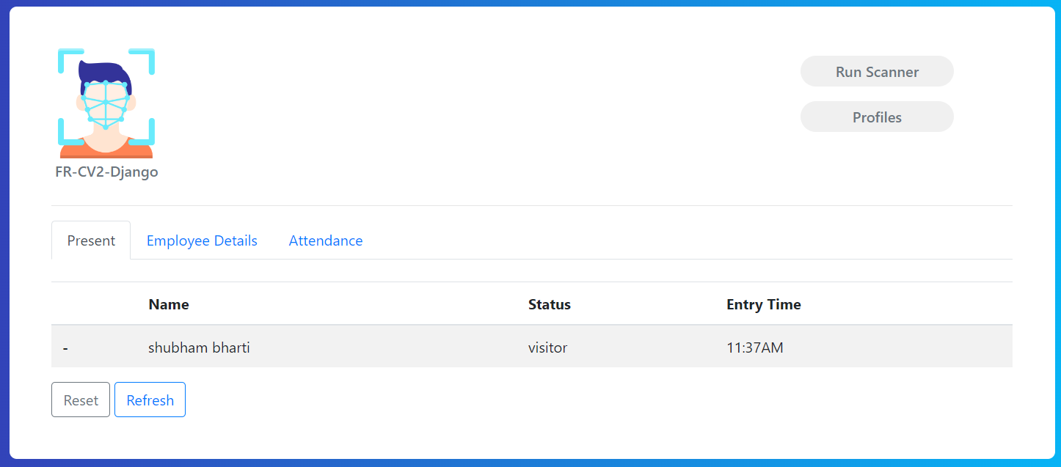

Slide 10
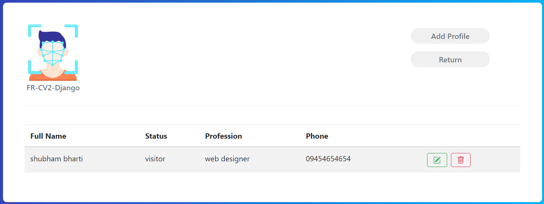


Slide 11
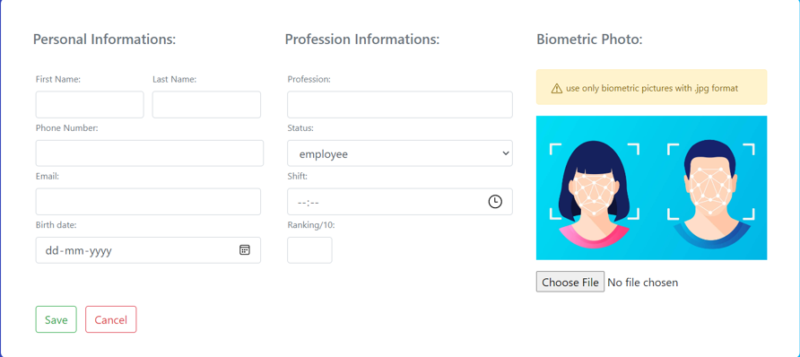

Slide 12
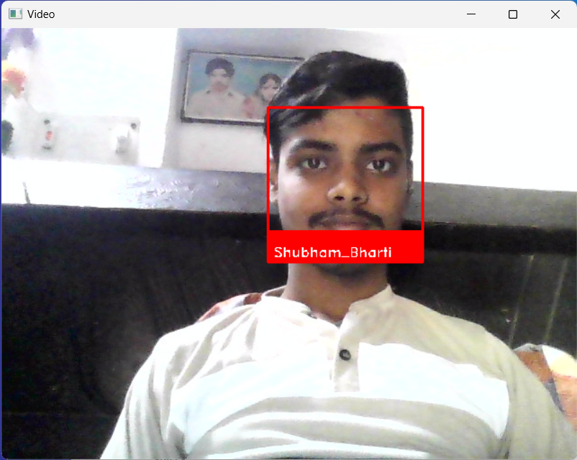

Slide 13
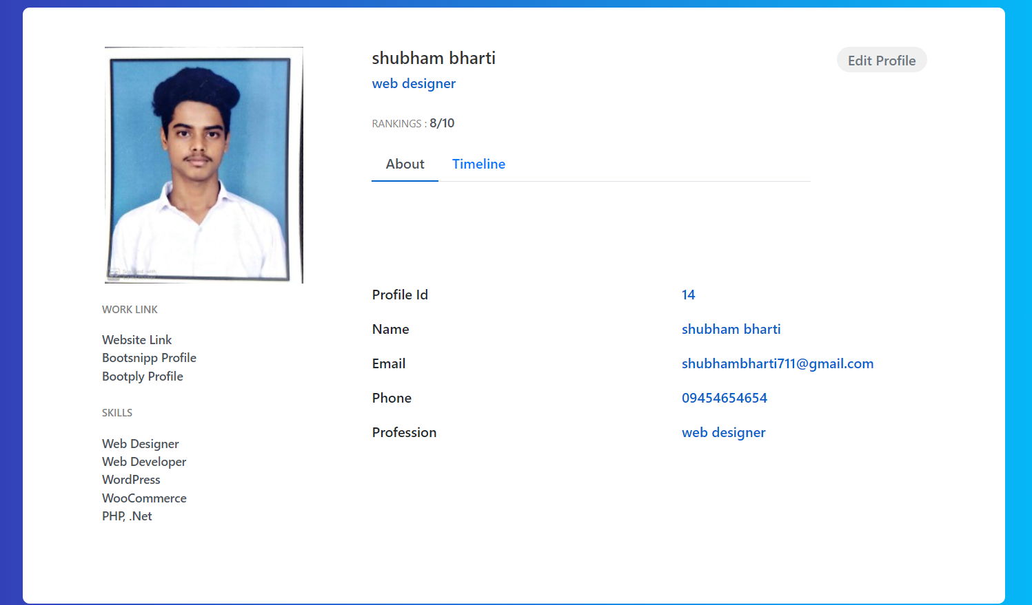

Slide 14
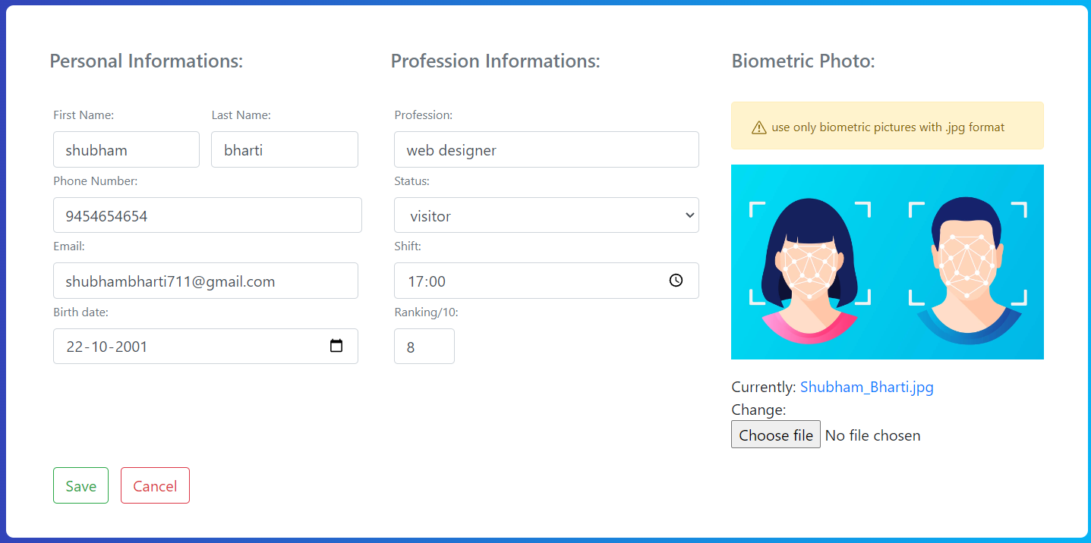

Slide 15
Advantages
Recognises correct data
Useful for non-touch ability
No data will be miss placed
Record can be maintained for long lactic
Flexible for changing data any time

Slide 16
Disadvantages
Sometime detects wrong data for wrong person due to same features of face
System can be corrupted
Data might be stolen by someone
Data base can be limited
Due to heavy entries, recognition process may affect

Slide 17
CONCLUSION
The result of the project was a successful prototype of a facial recognition system where the admin can create a teacher account and add students and their information to the database. Teachers then can log in to the system and take attendance of the student. The student’s face is detected by a camera and attendance is recorded in the database. Teachers and admin could see the attendance report of the students.

Slide 18

THANKYOU

